Slide 1


Simulacrum Analysis
Statistical metrics to compare (simulated) datasets
Edward Pearce
empearce1@sheffield.ac.uk

Slide 2
Outline
Why it’s important
What I did
What was the experience like?

Slide 3
Why it’s important
The Simulacrum is a tool for academic and clinical researchers to facilitate research based on the data held in the Cancer Analysis Service (CAS) whilst protecting patient confidentiality
Simulated datasets have the same table structure and aims to capture correlations between data fields
As new simulated datasets are produced for release, how closely do they resemble their real counterparts?

Slide 4

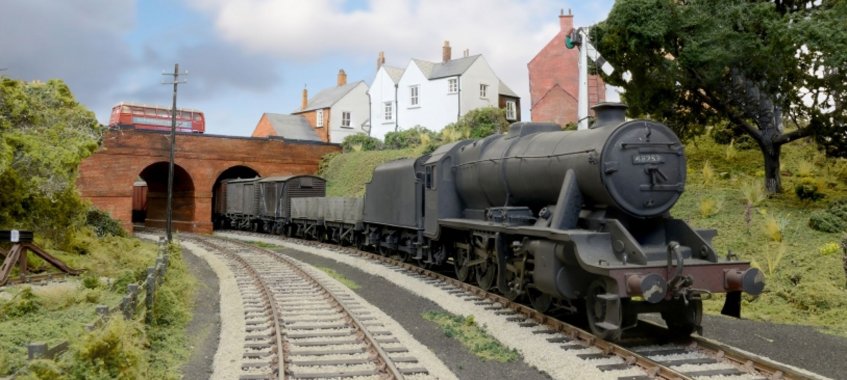
Assessing outputs of generative models
How well does the model output resemble the real thing?
Example task 1: Produce a picture of a train
Notes:
The CAS is a train, and the Simulacrum is a model train
Data is the cargo, with links between datasets (carriages)

Slide 5

Assessing outputs of generative models
How well does the model output resemble the real thing?
Example task 2:
Produce an image of a cat
Notes:
The CAS is a train, and the Simulacrum is a model train
Data is the cargo, with links between datasets (carriages)

Slide 6


Assessing outputs of generative models
How well does the model output resemble the real thing?
Example task 3: Produce images of human faces
Notes:
The CAS is a train, and the Simulacrum is a model train
Data is the cargo, with links between datasets (carriages)

Slide 7
What I did
HDI Summer Internship (10 weeks, July-September)
Extract the real and simulated outputs from the database
Clean, aggregate, and combine data for comparison
Measure the level of resemblance using statistical tests
These are our eyes to see how good the simulated outputs are for different features
Visualize the results
Automate steps 1-4 (!)

Slide 8
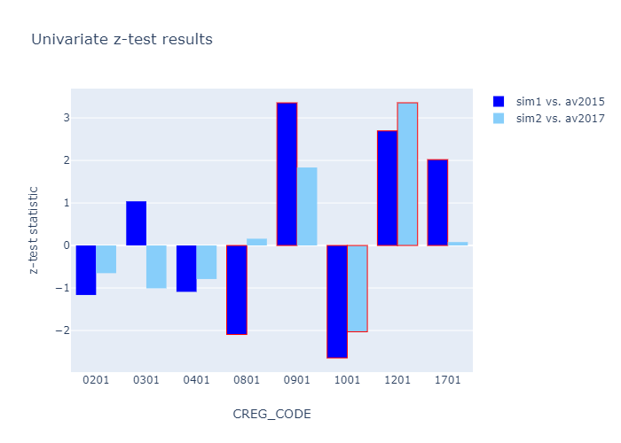

Slide 9
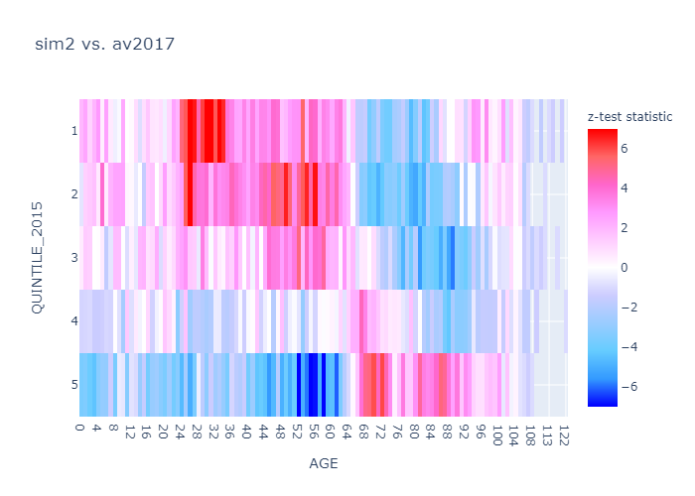

Slide 10

What was the experience like?
Learning new skills
Handling cancer data
Statistical tests
Programming (Oracle SQL, Python, Plotly)
Presentation skills
Chatting and interacting with other interns
Social activities
Working in a friendly, supportive environment

Slide 11


Thanks for listening!
Contact email: empearce1@sheffield.ac.uk
LinkedIn: https://linkedin.com/in/edwardm-pearce

Slide 12
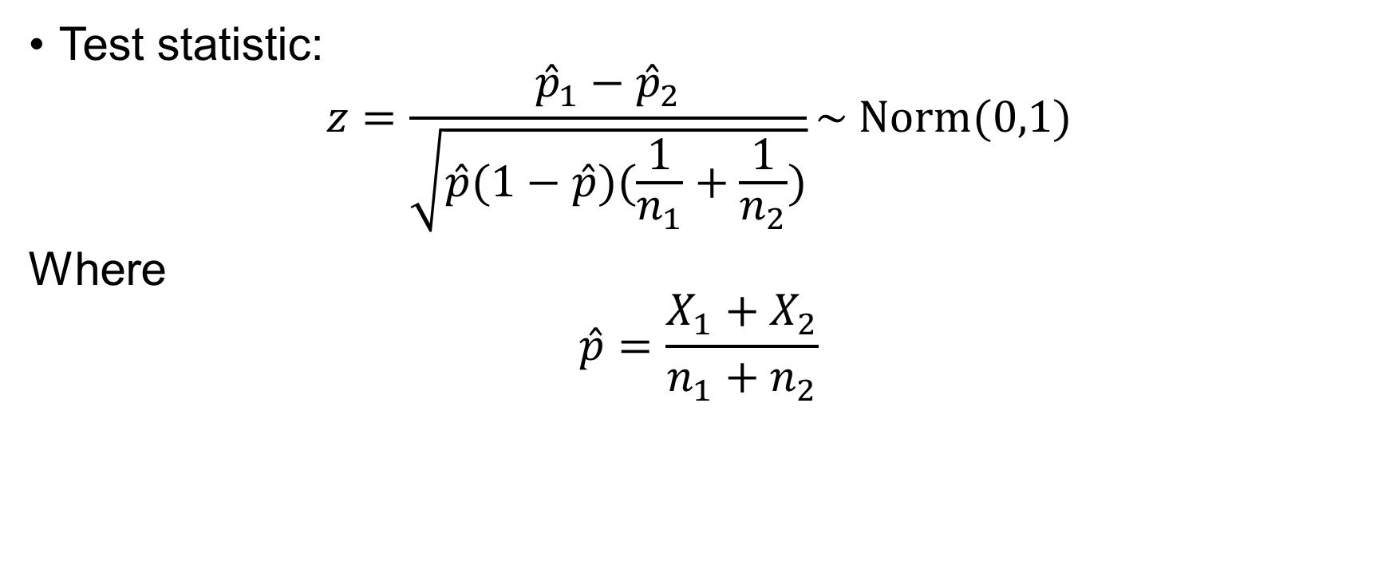
Pooled Two-sample z-test (Binomial)
Test statistic:
$$z=\frac{{\hat{p}}_{1}−{\hat{p}}_{2}}{\sqrt{\hat{p}(1−\hat{p})(\frac{1}{n_{1}}+\frac{1}{n_{2}})}}\sim Norm(0,1)$$
Where
$$\hat{p}=\frac{X_{1}+X_{2}}{n_{1}+n_{2}}$$

